Slide 1

CLASS 43 CD-404 BOX PLOT AND PIVOT PLOT UNIT 3
BOX PLOT AND PIVOT PLOT
Prof. Vineeta Shrivastava
Assistant Professor
Department of Computer Science & Engineering
LNCT-E, Bhopal
Lakshmi Narain College of Technology Excellence, Bhopal

Slide 2
CLASS 43 CD-404 BOX PLOT AND PIVOT PLOT UNIT 3
AGENDA
What is box plot?
Elements of Box Plot
Prof. Vineeta Shrivastava
Assistant Professor
Department of Computer Science & Engineering
LNCT-E, Bhopal
Lakshmi Narain College of Technology Excellence, Bhopal

Slide 3
CLASS 43 CD-404 BOX PLOT AND PIVOT PLOT UNIT 3
Box Plot
Box Plot is a graphical method to visualize data distribution for gaining insights and making informed decisions.
Box plot is a type of chart that seprates a group of numerical data through their quartiles.
Prof. Vineeta Shrivastava
Assistant Professor
Department of Computer Science & Engineering
LNCT-E, Bhopal
Lakshmi Narain College of Technology Excellence, Bhopal

Slide 4
CLASS 43 CD-404 BOX PLOT AND PIVOT PLOT UNIT 3
Box plot is also known as a whisker plot, box-and-whisker plot, or simply a box-and whisker diagram.
Box plot is a graphical representation of the distribution of a dataset. It displays key summary statistics such as the median, quartiles and potential outliers in a concise and visual manner.
By using Box plot you can provide a summary of the distribution, identify potential and compare different datasets in a compact and visual manner.
Prof. Vineeta Shrivastava
Assistant Professor
Department of Computer Science & Engineering
LNCT-E, Bhopal
Lakshmi Narain College of Technology Excellence, Bhopal

Slide 5
CLASS 43 CD-404 BOX PLOT AND PIVOT PLOT UNIT 3
Elements of Box Plot
A box plot gives a five-number summary of a set of data which is-
Minimum – It is the minimum value in the dataset excluding the outliers.
First Quartile (Q1) – 25% of the data lies below the First (lower) Quartile.
Median (Q2) – It is the mid-point of the dataset. Half of the values lie below it and half above.
Third Quartile (Q3) – 75% of the data lies below the Third (Upper) Quartile.
Maximum – It is the maximum value in the dataset excluding the outliers.
Prof. Vineeta Shrivastava
Assistant Professor
Department of Computer Science & Engineering
LNCT-E, Bhopal
Lakshmi Narain College of Technology Excellence, Bhopal

Slide 6
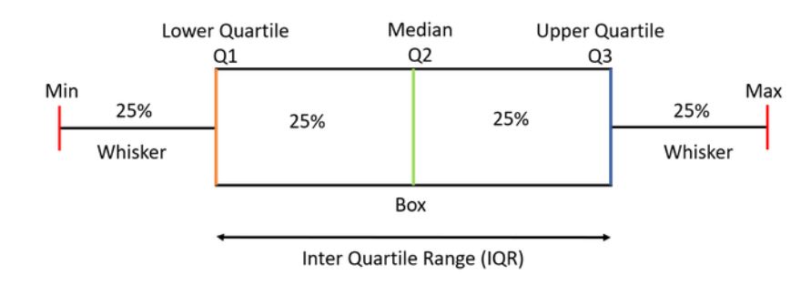
CLASS 43 CD-404 BOX PLOT AND PIVOT PLOT UNIT 3
Prof. Vineeta Shrivastava
Assistant Professor
Department of Computer Science & Engineering
LNCT-E, Bhopal
Lakshmi Narain College of Technology Excellence, Bhopal

Slide 7
CLASS 43 CD-404 BOX PLOT AND PIVOT PLOT UNIT 3
The area inside the box (50% of the data) is known as the Inter Quartile Range. The IQR is calculated as –
IQR=Q3-Q1
Outlies are the data points below and above the lower and upper limit. The lower and upper limit is calculated as –
Lower limit=Q1-1.5*IQR
Upper limit =Q3+1.5*IQR
Prof. Vineeta Shrivastava
Assistant Professor
Department of Computer Science & Engineering
LNCT-E, Bhopal
Lakshmi Narain College of Technology Excellence, Bhopal

Slide 8
CLASS 43 CD-404 BOX PLOT AND PIVOT PLOT UNIT 3
How to create a box plots?
Let us take a sample data to understand how to create a box plot.
Here are the runs scored by a cricket team in a league of 12 matches – 100, 120, 110, 150, 110, 140, 130, 170, 120, 220, 140, 110.
To draw a box plot for the given data first we need to arrange the data in ascending order and then find the minimum, first quartile, median, third quartile and the maximum.
Prof. Vineeta Shrivastava
Assistant Professor
Department of Computer Science & Engineering
LNCT-E, Bhopal
Lakshmi Narain College of Technology Excellence, Bhopal

Slide 9
CLASS 43 CD-404 BOX PLOT AND PIVOT PLOT UNIT 3
Ascending order
100,110,110,110,120,120,130,140,140,150,170,220
Median (Q2)=(120+130)/2=125
To find the First Quartile we take the first six values and find their median.
Q1=(110+110)/2=110
For the Third Quartile, we take the next six and find their median.
Q3=(140+150)/2=145
Prof. Vineeta Shrivastava
Assistant Professor
Department of Computer Science & Engineering
LNCT-E, Bhopal
Lakshmi Narain College of Technology Excellence, Bhopal

Slide 10
CLASS 43 CD-404 BOX PLOT AND PIVOT PLOT UNIT 3
If the total number of values is odd then we exclude the Median while calculating Q1 and Q3.
Here since there were two central values we included them. Now, we need to calculate the Inter Quartile Range.
IQR=Q3-Q1=145-110=35
Prof. Vineeta Shrivastava
Assistant Professor
Department of Computer Science & Engineering
LNCT-E, Bhopal
Lakshmi Narain College of Technology Excellence, Bhopal

Slide 11
CLASS 43 CD-404 BOX PLOT AND PIVOT PLOT UNIT 3
We can now calculate the Upper and Lower Limits to find the minimum and maximum values and also the outliers if any.
Lower limit=Q1-1.5*IQR=110-1.5*35=57.5
Upper limit=Q3+1.5*IQR=145+1.5*35=197.5
Min=100,Max=220
Prof. Vineeta Shrivastava
Assistant Professor
Department of Computer Science & Engineering
LNCT-E, Bhopal
Lakshmi Narain College of Technology Excellence, Bhopal

Slide 12
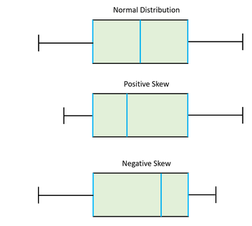
CLASS 43 CD-404 BOX PLOT AND PIVOT PLOT UNIT 3
Use-Cases of Box Plot
Box plots provide a visual summary of the data with which we can quickly identify the average value of the data, how dispersed the data is, whether the data is skewed or not (skewness).
The Median gives you the average value of the data.
Prof. Vineeta Shrivastava
Assistant Professor
Department of Computer Science & Engineering
LNCT-E, Bhopal
Lakshmi Narain College of Technology Excellence, Bhopal

Slide 13
CLASS 43 CD-404 BOX PLOT AND PIVOT PLOT UNIT 3
Pivot Plot
A pivot table is a table of statistics that summarizes the data of a more extensive table (such as from a database, spreadsheet, or business intelligence program). This summary might include sums, averages, or other statistics, which the pivot table groups together in a meaningful way.
Prof. Vineeta Shrivastava
Assistant Professor
Department of Computer Science & Engineering
LNCT-E, Bhopal
Lakshmi Narain College of Technology Excellence, Bhopal

Slide 14
CLASS 43 CD-404 BOX PLOT AND PIVOT PLOT UNIT 3
Heat Map
Heatmap is defined as a graphical representation of data using colors to visualize the value of the matrix.
In this, to represent more common values or higher activities brighter colors basically reddish colors are used and to represent less common or activity values, darker colors are preferred.
Heatmap is also defined by the name of the shading matrix.
Heatmaps in Seaborn can be plotted by using the seaborn.heatmap() function.
Prof. Vineeta Shrivastava
Assistant Professor
Department of Computer Science & Engineering
LNCT-E, Bhopal
Lakshmi Narain College of Technology Excellence, Bhopal

Slide 15
CLASS 43 CD-404 BOX PLOT AND PIVOT PLOT UNIT 3
Important Parameters:
data: 2D dataset that can be coerced into an ndarray.
vmin, vmax: Values to anchor the colormap, otherwise they are inferred from the data and other keyword arguments.
cmap: The mapping from data values to color space.
annot: If True, write the data value in each cell.
Prof. Vineeta Shrivastava
Assistant Professor
Department of Computer Science & Engineering
LNCT-E, Bhopal
Lakshmi Narain College of Technology Excellence, Bhopal

Slide 16
CLASS 43 CD-404 BOX PLOT AND PIVOT PLOT UNIT 3
THANKYOU
Prof. Vineeta Shrivastava
Assistant Professor
Department of Computer Science & Engineering
LNCT-E, Bhopal
Lakshmi Narain College of Technology Excellence, Bhopal

